Slide 1
Residential Demographic Multipliers: A Tool for Planners and Policy makers
Center for Urban Policy Research, Bloustein School of Planning and Policy, Rutgers University
April 8, 2025
David Listokin and Umer Farooq

Slide 2
Introduction of Rutgers Demographic Multipliers
• Developed by Dr. Listokin and Dr. Voicu for the Center for Urban Policy Research (CUPR) at Rutgers University’s Edward J. Bloustein School of Planning and Public Policy.
• Supported by the National Science Foundation, based on 2017–2021 American Community Survey (ACS) data.
• Provide detailed profiles of residents by housing type, size, tenure, and value across all 50 states, DC, and Puerto Rico.
• Originally designed to assist planners, developers, and policymakers with estimating population and school-age children per housing unit.

Slide 3
What Are Demographic Multipliers?
Show average number and profile of people per housing type.
Based on 2017–2021 ACS data for all 50 states.
Breakdowns by structure type, bedroom count, tenure, housing value, and age.
E.g., 4-bedroom detached home = 3.3 people, 0.9 school-age children.

Slide 4
Rutgers Multiplier Data Tools
• Available in three formats for user flexibility:
1. State Tables – Explore housing and population characteristics for each of the 50 states.
2. Online Database – Compare housing impacts across jurisdictions via an interactive tool.
3. Monograph – Comprehensive guide with background, methodology, and a New Jersey case study.
• The monograph is ideal for understanding context and methodological depth, while the database is best for rapid access to key figures.

Slide 5
Why Do These Matter? – Key Uses of DMs
1. Fiscal Impact Analysis (FIA): Estimate municipal/school costs and revenues.
2. Impact Fees: Allocate proportional infrastructure costs (e.g., new school capacity).
3. School Enrollment Projections: Forecast children from new residential development.
4. Public Staffing Analysis: Assess staffing needs (e.g., teachers per pupil).
5. Age-Specific Needs: Understand demand for youth/senior services.
6. Market Studies: Evaluate potential buyers/renters and household profiles.
7. Public Policy: Analyze fiscal impact of policies (e.g., climate-related buyouts).
8. Energy Demand Forecasting: Estimate utility needs by household density and structure type.

Slide 6
How Is the Data Structured?
• Housing Location
- Newer Built Housing: Units built 2000–2021.
- All Age Housing: Units built in any year (newer + older).
Structure and Tenure (Total 9 structures and tenure categories)
1. Household Size (HS)
2. Age Breakdown: 0–4, 5–17, 18–34, 35–44, 45–54, 55–64, 65–74, 75+
3. School-Age Children (SAC): Ages 5–17
4. Public School Children (PSC): SAC attending public school
5. Grade Breakdown: K–5, 6–8, 9–12
6. Statistical Metrics: Sample size, standard error, CI, error margin
8. Statistical Metrics: Sample size, standard error, CI, error margin
• Two housing age categories:
• Core Demographic Data Categories (Total 9 Data Categories)
Number of Bedrooms for each structure type.
Housing Value
Terciles and Below and Above medians

Slide 7
Demo – Streamlit App
URL: https://demographics-rutgers.streamlit.app/
Example: California, 3-bedroom, rental, newer housing.
Outputs: HS = 3.1, SAC = 1.0, PSC = 0.8 (with CI and error margin).
Interactive filters for state, unit type, bedrooms, and tenure.

Slide 8
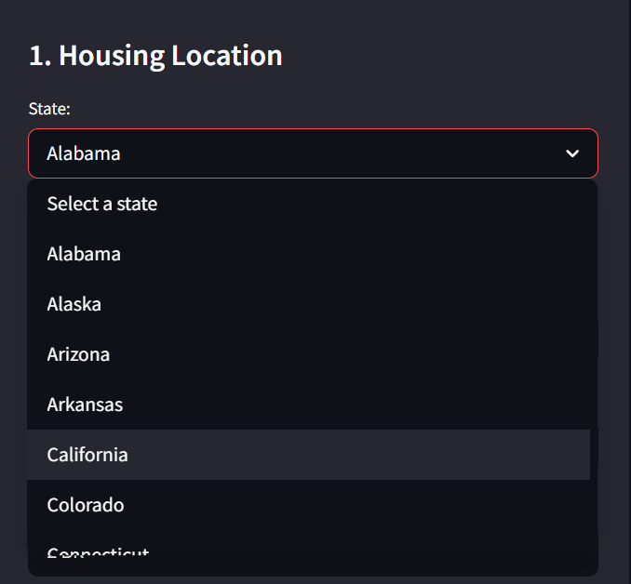
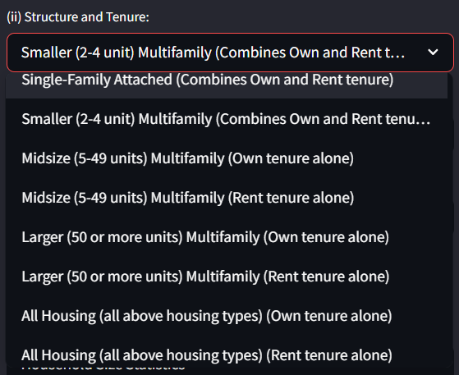
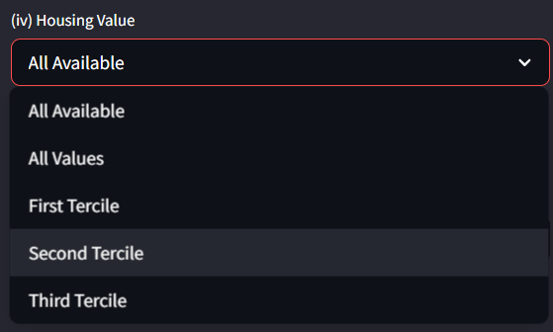
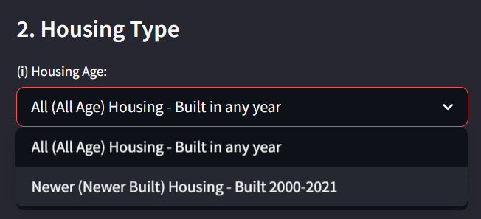
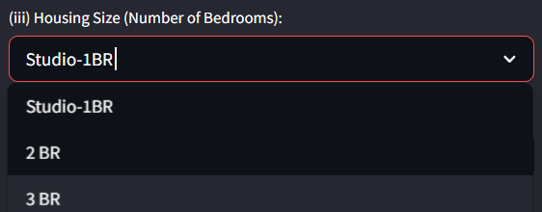
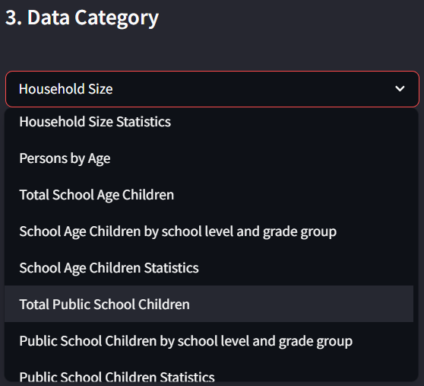
Demo – Streamlit App
https://demographics-rutgers.streamlit.app/

Slide 9
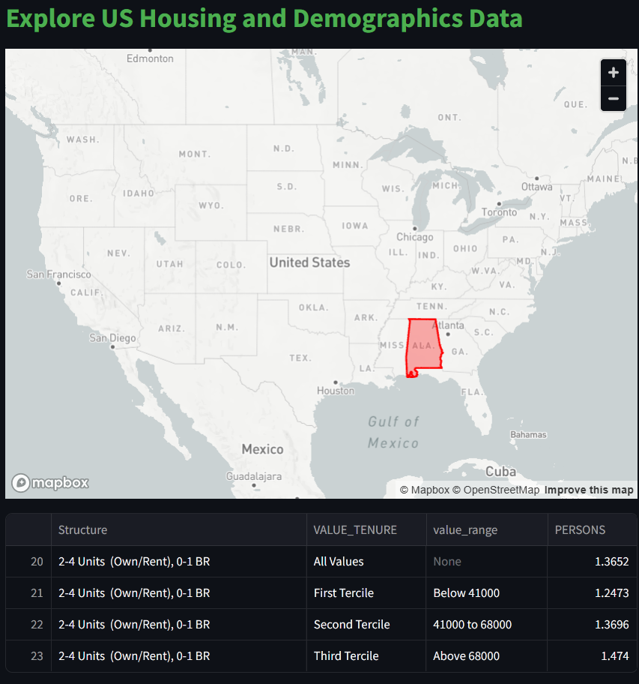
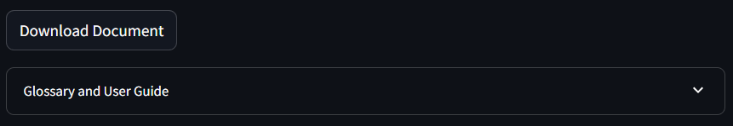
Demo – Streamlit App
Detailed Overview, user guide, and definitions are present on the application to read.
https://demographics-rutgers.streamlit.app/

Slide 10
Statistical Rigor
Sample Size (N)
Standard Error (SE)
Confidence Interval (CI) – 90%
Error Margin (%) – Preferably <50%
Transparent and statistically grounded estimates.

Slide 11
Broader Impacts
Urban Expansion: Plan infrastructure and services.
Energy Use: Grid planning based on occupancy patterns.
Climate Adaptation: Buyouts and zoning strategy.
Equity & Affordability: Understand resident profiles by housing type.

Slide 12
Takeaways
Multipliers are data-rich and application-driven.
Designed for planners, policymakers, and analysts.
Available on the Streamlit platform with full state datasets.
Explore more via the full monograph and quick guide.

